Slide 1
Download genomes from NCBI in batch

Slide 2
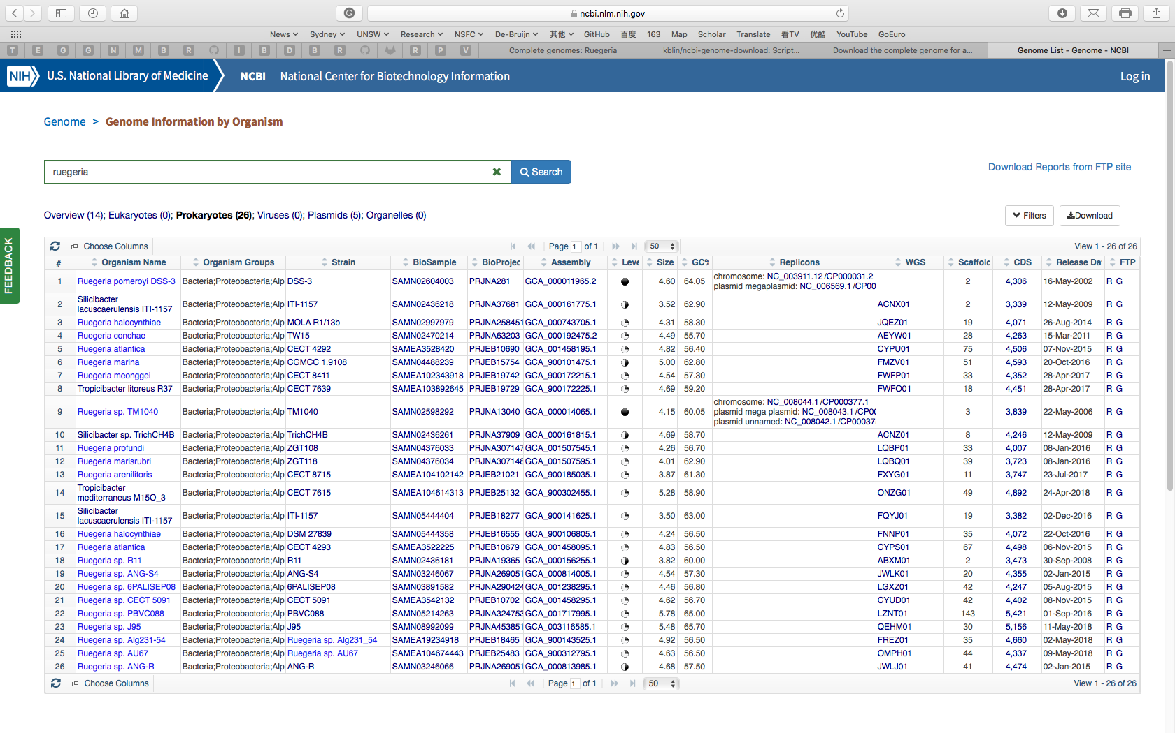
https://www.ncbi.nlm.nih.gov/genome/browse#!/prokaryotes/ruegeria

Slide 3
wget ftp://ftp.ncbi.nlm.nih.gov/genomes/all/GCF/000/014/065/GCF_000014065.1_ASM1406v1/GCF_000014065.1_ASM1406v1_genomic.fna.gz
Or:
python3 batch_download_NCBI_genomes.py
ftp://ftp.ncbi.nlm.nih.gov//genomes/GENOME_REPORTS/prokaryotes.txt

